Slide 1
CSE 219
Computer Science III
Properties of
High Quality Software

Slide 2
This semester I intend to brainwash you
Important Principles for creating a Software Solution:
First, define the problem
Design, then code
Always Provide Feedback
First, define the problem
Design, then code
Always Provide Feedback
First, define the problem
Design, then code
Always Provide Feedback
First, define the problem
Design, then code
Always Provide Feedback
First, define the problem
Design, then code
Always Provide Feedback
First, define the problem
Design, then code
Always Provide Feedback

Slide 3
Do you remember why we’re here?
To learn a methodology for constructing software systems of high quality
Do you remember:
  what makes software high quality?
  the Software Development Life Cycle?

Slide 4
What properties make a software system high quality?
Correctness
Efficiency
Ease of use
  for the user
  for other programmers using your framework
Reliability/robustness
Reusability
Extensibility
Scalability
Maintainability, Readability, Modifiability, Testability, etc.

Slide 5
Correctness
Does the program perform its intended function?
  And does it produce the correct results?
This is not just an implementation (coding) issue
  Correctness is a function of the problem definition
A flawed Requirements Analysis results in a flawed Design
A flawed Design results in a flawed program

Slide 6
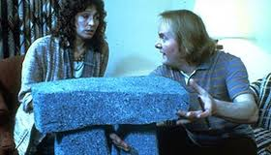
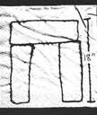
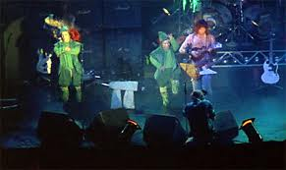
Garbage In – Garbage Out
Ever see This is Spinal Tap?

Slide 7

Efficiency
Plan for efficiency
  wisely choose your data structures & algorthms, O(N), in the design phase
  tools & technologies too
Does the program meet user performance expectations?
If not, find the bottlenecks
  done after implementation
  called profiling

Slide 8
Ease of Use for End User
Is the GUI easy to learn to use?
  a gently sloped learning curve
What makes a GUI easy to use?
  familiar GUI structures
  familiar icons when possible instead of text
  components logically organized & grouped
  appealing to look at
    colors, alignment, balance, etc.
  forgiving of user mistakes
  help, tooltips, and other cues available
  etc.

Slide 9
Ease of Use for other Programmers
In particular for frameworks
  think of the Java API developers
Should you even build a framework?
What makes a framework easy to use?
  logical structure (should mirror problem)
  naming choices (classes, methods, etc.)
  flexibility (usable for many purposes)
  feedback (exceptions for improper use)
  documentation (APIs & tutorials)
  etc.

Slide 10
Reliability/Robustness
Does your program:
  anticipate erroneous input?
  anticipate all potential program conditions?
  handle erroneous input intelligently?
    again, think about this in the design stage
  provide graceful degradation?
What’s graceful degradation?

Slide 11
Graceful Degradation
An error condition occurs in your program
Should your program:
  crash?
  exit?
  notify the user and exit?
  provide an approximated service?
    not always possible
Web Browsers
  What does they do with poorly formatted HTML?

Slide 12
Feedback, Feedback, Feedback, Feedback
Feedback
Feedback
Feedback
Feedback
Feedback
Feedback
Feedback
Feedback
Feedback
Feedback
Feedback
Feedback
Feedback
Feedback

Slide 13
Feedback to whom?
End user due to:
  bad input, equipment failure, missing files, etc.
How?
  popup dialogs, highlighting (red x in Web form), etc.
Other programmers using your framework due to:
  passing bad data, incorrect initialization, etc.
How?
  exception throwing, error value returning, etc.

Slide 14
Flexibility in a Framework
Programmers need to know:
  when and why things in a framework might go wrong
  AND
  When and why things in a framework do go wrong
Why?
  customized response
  Ex:
    System.out.println notification
    JOptionPane notification
    Web page generated and sent via Servlet notification
    use alternative services
    etc.

Slide 15
Applications Using Frameworks
Framework
App1 calls methods of Framework objects
App2 calls methods of Framework objects
Framework calls methods of App1 & App2 objects
Application #1
Application #2
Note, making a framework is much more difficult than making an application. Why?

Slide 16
Reusability
Code serving multiple purposes
Who cares?
  management does
    avoid duplication of work (save $)
  software engineering does
    avoid duplication of work (save time & avoid mistakes)
How can we achieve this?
  careful program decomposition
  separate technology-dependent components

Slide 17
Extensibility
Can the software easily be extended?
Huh?
  can it be used for other purposes
Ex:
  plug-ins
  exporters
  add-ons
  etc

Slide 18
Extensibility Example
In NetBeans, try Tools → Plugins
Anyone can make a plugin
Download, install, and use

Slide 19
Scalability
How will the program perform when we increase:
  # of users/connections
  amount of data processed
  # of geographic locations users are from
A function of design as well as technology

Slide 20
And More
Maintainability
Readability
Modifiability
Testability
etc.
All of these, as with the others, must be considered early in design

Slide 21
How can these properties be achieved?
By using well proven, established processes
  preferably while taking advantage of good tools
Software Development Life Cycle
Requirements Analysis
Design & Document
Evaluate Design
Code
Test
Deploy
Profile
Debug

Slide 22
How can these properties be achieved?
By using well proven, established processes
  preferably while taking advantage of good tools
Software Development Life Cycle
Requirements Analysis
Design & Document
Evaluate Design
Code
Test
Deploy
Profile
Debug

Slide 23
Hopefully, the point of no return
Correctness, Efficiency, Ease of use, Reliability/robustness, Reusability, Maintainability, Modifiability, Testability, Extensibility, Scalability
When should we consider these properties?
  the requirements analysis & design stages
How about the implementation stages?
  too late to make a big impact

Slide 24
Where to begin?
Understand and Define the problem
  the point of a requirements analysis
  What are system input & output?
  How will users interact with the system?
  What data must the system maintain?
Generate a problem specification document
  defines the problem
  defines what needs to be done to solve the problem
  I'll do this for you this semester

Slide 25
Requirements Analysis
i.e. Software Specification (spec.)
A textual document
It serves two roles. It:
  defines the problem to be solved
  explains how to solve it
This is the input into the software design stage

Slide 26
What goes in a requirements analysis (RA)?
The why, where, when, what, how, and who
  Why are we making this software?
  Where and when will it be created?
  What, exactly, are we going to make?
  How are we going to make it?
  Who will be performing each role?

Slide 27
What really goes in a RA?
Detailed descriptions of all:
  necessary data
  program input and output
  GUI screens & controls (
  user actions and program reactions
For a database:
  necessary forms & views

Slide 28
Where do you start?
Interviews (really)
Who do you interview?
  end users
What do they need?
What do they want?

Slide 29
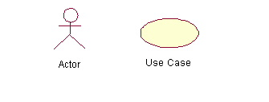
UML Use Case Diagrams
A set of scenarios that describe an interaction between a user and a system
Done first in a project design
  helps you to better understand the system requirements
To draw a Use Case Diagram:
  List a sequence of steps a user might take in order to complete an action.
  Example actor: a user placing an order with a sales company

Slide 30
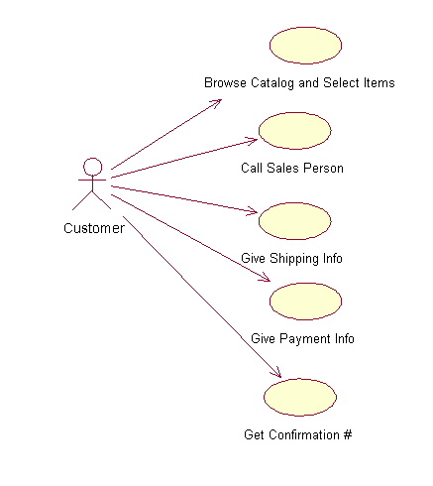

Slide 31
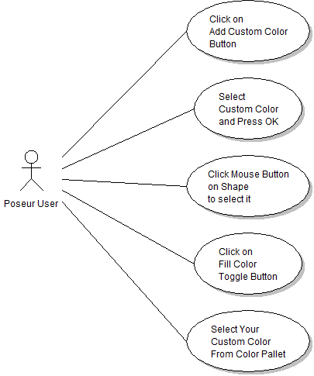
Poseur – Fill shape with custom color

Slide 32
UML Use Case Diagrams
Fed as input to the next step
What's that?
  UML design
But first we'll get deep into OOP
  Next lecture

